Slide 1
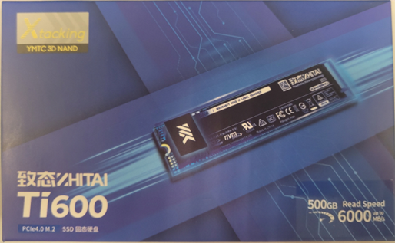
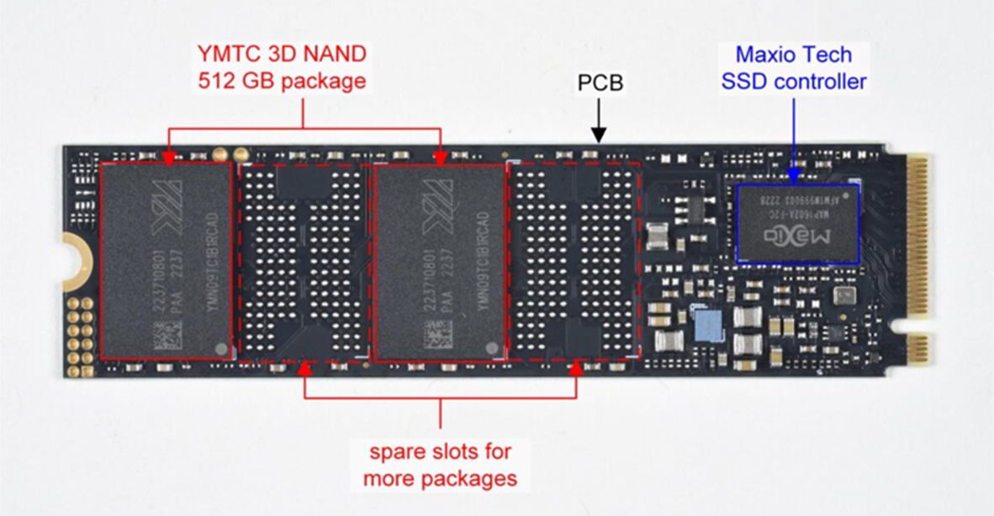
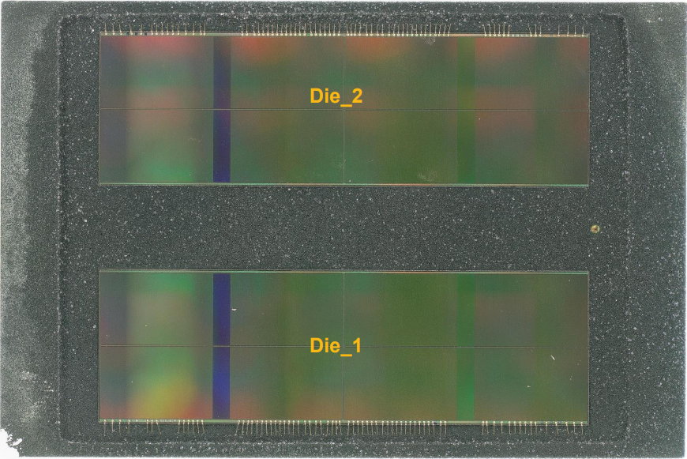
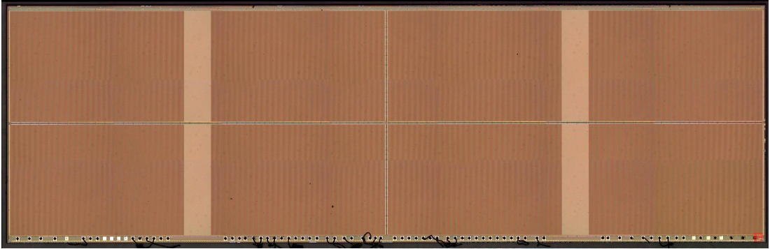
YMTC 3D NAND 232Layers QLC (EMS 峨嵋山)
12.88 mm
4.02 mm
SSD capacity: 512GB
Die capacity: 1Tb
Plane Number: 4
Die size: 12.88 x 4.02 = 51.91mm^2
plane

Slide 2
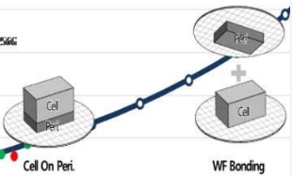
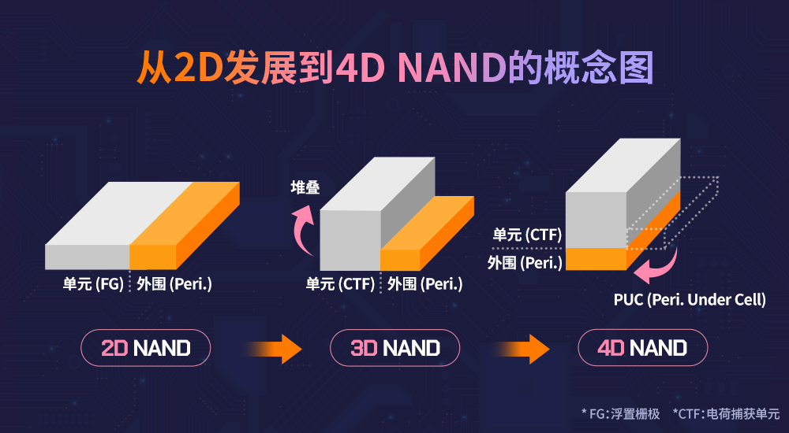
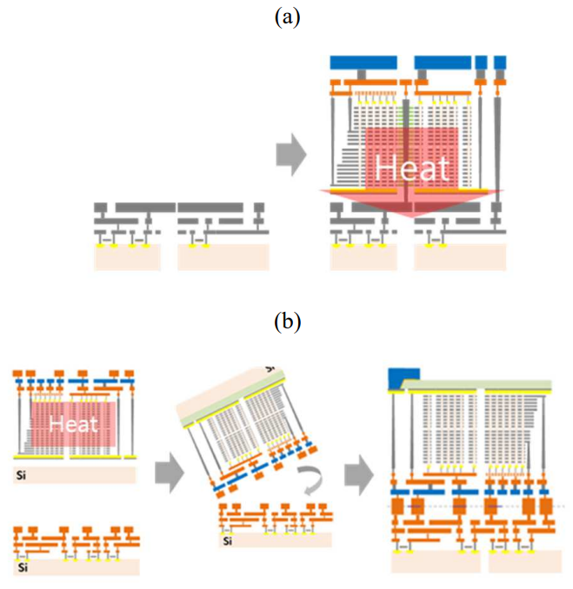
Technology Development
記憶體堆疊對邏輯電路產生的熱傷害，隨著層數增加而加劇。晶圓對接有助於降低熱傷害的影響。
長江存儲是第一個提出晶圓對接的記憶體廠家。

Slide 3
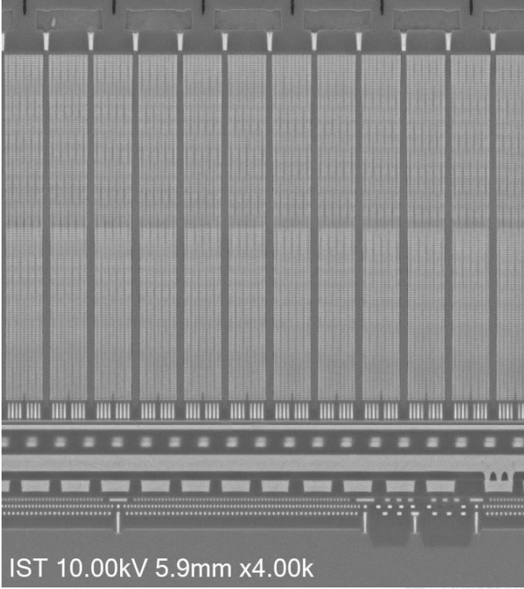
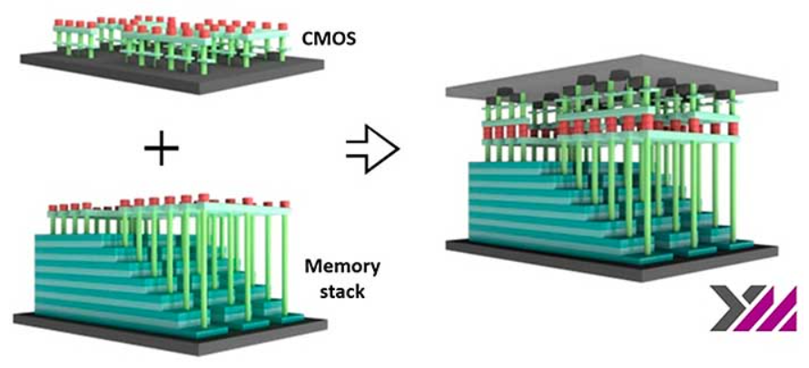
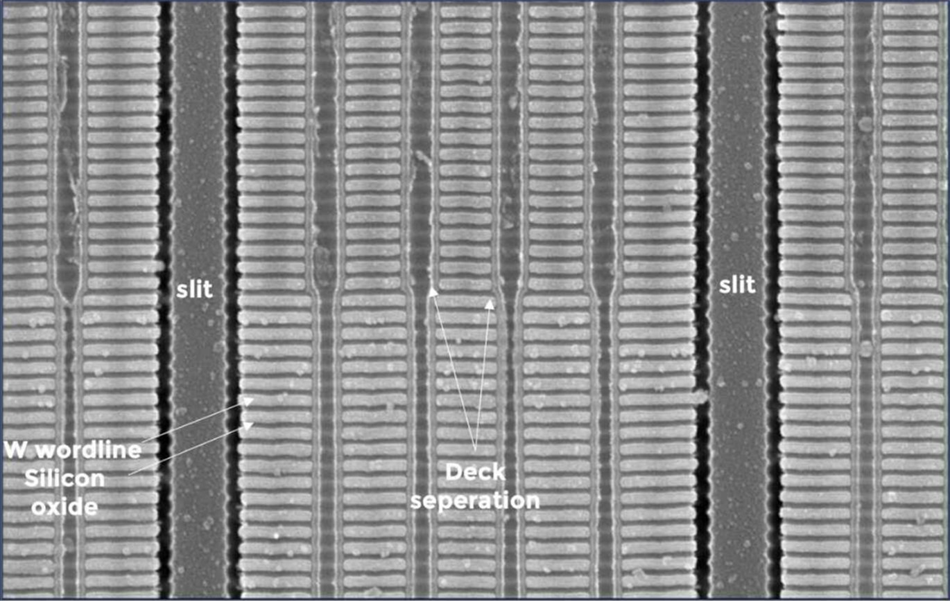
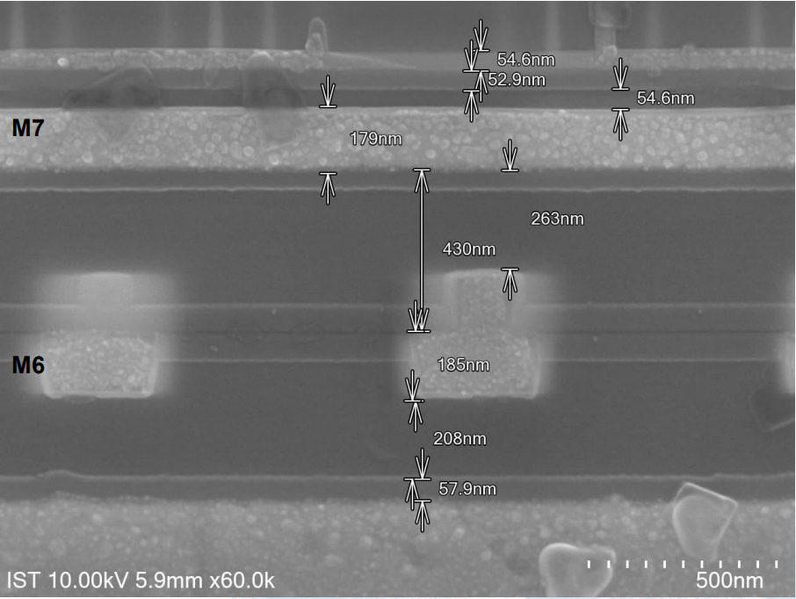
SEM電子顯微鏡影像
BSSC
(Backside Source Contact)
Desk1
128 Layers
(6.28um)
String stacking
String stacking
Memory wafer
128L
232L
125 Layers
(6.13um)
125L
Desk2
Xtacking
Xtacking
Bonding interface
CMOS wafer
CMOS substrate

Slide 4
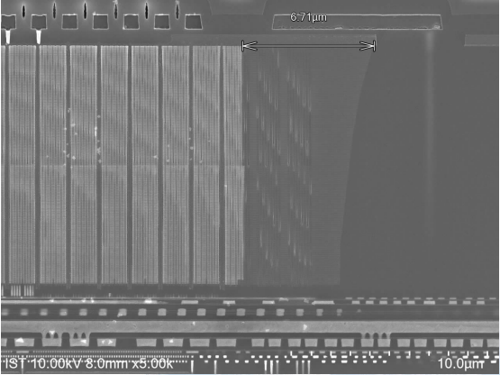
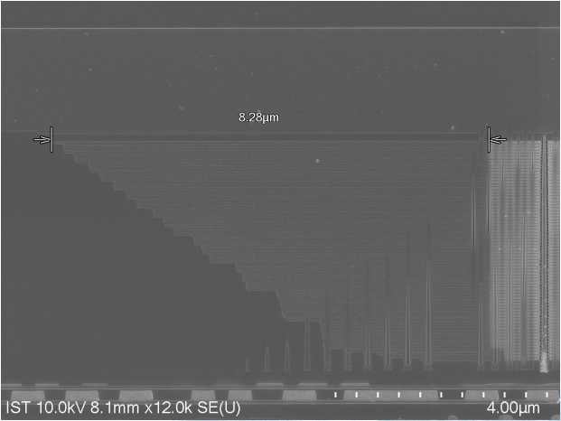
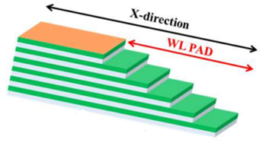
Staircase
 |  |  | 64L->232L
 | 232L | 64L | Improve Ratio
Layer Number | 253 | 72 | +351%
Height(nm) | 12400 | 4170 | +297%
Layer Thickness(nm) | 49.01 | 57.92 | -15%
Memory height increases ~297%
Staircase width reduces ~19%
232L VCE (Vertical Gate Efficiency) 91.6%, 64L VCE 88.8%
YMTC EMS 232L
YMTC JGS 64L
6.71um
128L
8.28um
12.4um
72L
125L
4.17um

